Slide 1
Why Do Requirements?
Symptoms of Software Development Problems
User or business needs not met
Requirements churn
Modules don’t integrate
Hard to maintain
Late discovery of flaws
Poor quality or end-user experience
Poor performance under load
No coordinated team effort
Build-and-release issues

Slide 2
Why Do Requirements?
Symptoms of Software Development Problems
  Users do not know what they really want
  Users are unable to articulate what they want
  Developers think they understand user problems better than users
  Stakeholders think they know what they want, but don’t recognize it when delivered
  Everybody believes everyone else is politically motivated

Slide 3
What is a Requirement?
Requirement
  A condition or capability to which the system must conform
  Define WHAT the system should do rather than how the system does it
Notes:
It’s a good idea to have some examples of requirements to make this definition less abstract. Include functional requirements such as would be included in a use-case model. Also include performance, legal, availability, and so on. For an ATM machine, a functional requirement might be “withdraw cash.” An example of a performance requirement might be to validate the customer ID within 5 seconds.

Slide 4
What is Requirements Management?
Systematic Approach to Organizing and Managing Requirements of a System
Helps Establish and Maintain Agreement between the Customer and the Project Team on Requirements Produced
Helps Ensure Clear and Concise Requirements
  Plain-language expressions
  Bridges the gap between technical and non-technical users
Helps Ensure the Correct Requirements are Produced
  Established traceability among business needs, features, and system requirements throughout the product life cycle
Notes:
At least 11 bottlenecks
Simple: Easy to use – which is not the spec
Adequate: Cover the functional need – which the spec is not since work is still being completed manually.
Interactive rules: Which it is not, and which is why Delivery manually moves items in the stub.

Slide 5
Requirements Management Territory
Problem
Problem Space
Needs
Solution Space
Features
Traceability
The Product to Be Built
System
Requirements
Test Scripts
Design
User Docs

Slide 6
Requirements Management Plan
Types of Requirements to Collect
Types of Attributes to Track
Types of Requirements to Trace
Types of Documents to Produce
Management Guidelines
Notes:
Review agenda

Slide 7
Requirements Artifacts, Types, and Attributes
Definition
Requirements Artifacts
  Created to help store and organize both system and business requirements (e.g. Microsoft Word Documents)
Requirement Types
  Specific subsets of requirement information that will be collected during the requirements phase
Requirement Attributes
  Specific data elements about requirements (e.g. Product Features are “Proposed”, “Approved”, or ‘Incorporated”)
  Are defined for each requirement type in each artifact
Notes:
Review agenda

Slide 8
Requirements Artifacts and Types
InfoPro Customization: Artifact #1
Product Initiation Report
  High-Level Definition of the Project, Assumptions, Key Tasks, Risks, Recommendations, Project Costs and Timelines
Requirement Types
  Stakeholder Requests and Business Needs
Notes:
Review agenda

Slide 9
Requirements Artifacts and Types
InfoPro Customization: Artifact #2
Feature-Set Document
  High-Level User Needs and Product Features
  Details Business Requirements, Provides Scoping, and Prioritizes Features
  Focuses on the Capabilities of End-Users and Also their Benefits
Requirement Types
  Problem Statement, Stakeholder Roles and Responsibilities, Actors/End-Users, Product Features/Attributes, Business Constraints, Feature Exclusions, Alternatives, Competition, References, Documentation Requirements, Project Glossary
Notes:
Review agenda

Slide 10
Requirements Artifacts and Types
InfoPro Customization: Artifact #3
Requirement Specification Document
  Fully describes the behavior of the system identified
  Addresses “As-Is” and “To-Be” detailed system requirements, implementation, and other constraints
  Provides a Complete and Comprehensive Description of the Requirements for the Project
Requirement Types
  Existing Functionality, Business Rules, Not-In-Scope Functionality, Desired Functionality including Workflows, Functional and Non-Functional Requirements, Screen Prototypes-Mock-ups, Documentation Requirements, System Constraints, Technical Architecture Considerations, Glossary
Notes:
Review agenda

Slide 11
Product Features
Is an externally observable service by which the system directly fulfills a stakeholder need
Examples:
  The Defect Tracking System will provide trending information to help the project manager assess project status.
  The ATM must allow a customer to transfer funds between accounts.
  The graphical user interface will provide context-sensitive help.
Notes:
The heart of the Vision document is the list of features for the product. Features are a type of requirement that directly fulfills a stakeholder need. These are the types of statements that came out in the class brainstorming session about features.
The features show exactly what the system to be built will do. The features are listed in the Vision document.
Because the Vision document is reviewed by a wide variety of involved personnel, the level of detail should be general enough for everyone to understand. However, enough detail should be available to provide the team with the information they need to create a use-case model.
Each feature should be externally perceivable by users, operators, or other external systems. These features should include a description of functionality and any relevant usability issues that must be addressed. Focus on the capabilities needed and why, (not how) they should be implemented.
Each feature is expanded in greater detail in the use-case model. As you continue to develop the requirements in later modules, discuss how to write the detailed software requirements.
Make a point that these are similar to the types of statements that came out in the brainstorming session earlier.
Point out that one definition of “feature” listed in Webster’s Dictionary is “an advertised benefit.” The types of items we will consider as features are those that could be advertised as benefits.
Each feature directly fulfills a stakeholder need. Often there are many lower-level software requirements that trace back to a single feature.
What is similar between the use cases and the features? [Answer: System functionality]
What is different about the perspective on the functionality? [One of many answers: Features are described from the system perspective, use cases are named from the user perspective.]
Caution to students: You do not get uses cases from features.

Slide 12
Requirements Artifacts and Types
InfoPro Customization: Artifact #4
Traceability Matrix Document
  Traces Requirement Types between and throughout the Product Lifecycle
  Requirement Types are Coded and Numbered
Requirement Types
  Business Needs to Product Features
  Product Features to System Requirements
  System Requirements to Screen Shots-Prototype/Mock-Ups
Notes:
Review agenda

Slide 13
Requirements Management Approach
InfoPro Customization Requirement Roles
User | Activity
David Stanton | The Lead Requirements Developer who will elicit and document requirements, perform reviews, walkthroughs, and will attend design review
Anne Maurer | The Project Manager for InfoPro Customization who will log issues, manage project costs, and timelines
Project Stakeholders | An IRI employee identified as a project stakeholder who will review and approve business feature and system requirements
Subject Matter Experts (SMEs) | Experts in related topics who will attend the requirements kickoff session, requirements elicitation meetings, and review and approve business and system requirements
QE | A member of the quality engineer team who will review artifacts and ensure quality plan is met
QA | A member of the quality assurance team who will attend requirements review sessions and ensure requirements are testable
Notes:
Review agenda

Slide 14
Traceability Model
Trace Requirements throughout the Product Lifecycle
Trace Requirements Between Requirement Types
  Business Needs to Product Features
  Product Features to System Requirements
  System Requirements to Screen Shots-Prototype/Mock-Ups
  System Requirements to Design, Test, Implementation etc.
Notes:
Review agenda

Slide 15
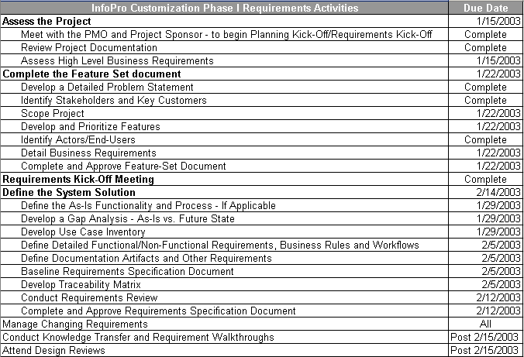
InfoPro Customization Project – Phase 1
Automation of the Measure Template Process
Notes:
Review agenda

Slide 16
Management Guidelines
InfoPro Customization Project
Management Guidelines are needed for Managing Changing Requirements Throughout the Project
Must Adhere to the PMO Change Control Process
  Change Request is Received
  Impact Analysis is Performed
  Requirements Changes are Baselined
  Lead Requirements Developer Updates Requirements Artifacts
Notes:
Review agenda

Slide 17
How the Requirements Group Fits Into IRI
Recently Moved from the Technology Group to the PMO as of 12/15/02
Report to Jeanne Livelsberger
  Jonah Ellin – Requirements Director
  Claire Gourdain-Dwyer – Requirements Director
  David Stanton – Requirements Director
  Don Willis – Requirements Director
Serve as Requirements Developers and Advisors
Involved in Requirements Development and Management Activities Utilizing the Product Development Lifecycle (PDLC) for the Entire IRI Organization

